Slide 1

Unveiling Netflix: Exploring Trends and Insights
A Journey through Data Discovery and Analysis

Slide 2

Dataset Introduction and Project Objectives
In this project, I delved into the world of Netflix shows using a dataset specifically curated for this purpose. My primary goal was to gain proficiency in MySQL tools for data analysis and manipulation. By exploring the dataset, I aimed to extract valuable insights into Netflix's content landscape, understand trends in show genres, durations, release years, and more. Through this exploration, my objectives were to enhance my skills in querying databases, performing data transformations, and visualizing results. Ultimately, this project served as a steppingstone to build confidence in handling real-world datasets and harnessing MySQL's capabilities for insightful data exploration.

Slide 3
Project Overview: Netflix Data Analysis
Import Process:
To begin the analysis, I imported the Netflix dataset into MySQL. This process involved several key steps. First, I ensured the dataset was in CSV format and checked for any inconsistencies or missing values. Then, I created a new database in MySQL and defined a table structure that matched the dataset's columns. Using MySQL's import functionality, I uploaded the CSV file into the newly created table. Finally, I performed initial data validation checks to confirm the integrity and accuracy of the imported data. This import process was crucial for setting a solid foundation for subsequent data analysis and querying.

Slide 4

Project Overview: Netflix Data Analysis
Interesting Findings:
One of the most intriguing findings from the dataset was the significant diversity in content ratings. I discovered that TV-MA was the most prevalent rating among Netflix shows, indicating a strong preference for mature content among viewers. Conversely, TV-G had the least representation, with only two programs in this category. This contrast highlights Netflix's strategic focus on catering to a more mature audience, while still offering a wide range of content suitable for all age groups.

Slide 5
Cool Facts: Netflix Genre Diversity & Content Breakdown
Genre Diversity:
The dataset uncovered a fascinating trend of increasing genre diversity on Netflix, with a notable rise in niche categories like sci-fi fantasy, crime thrillers, and documentaries, reflecting the platform's efforts to cater to diverse viewer preferences.
Content Breakdown:
The dataset consisted of a balanced mix of content types, with 55 movies and 45 TV shows. This breakdown demonstrates Netflix's strategy of offering a diverse range of content to meet various viewer preferences.

Slide 6
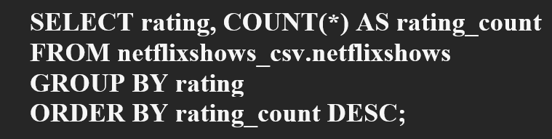
Netflix Insights: Content Ratings & Type Distribution
Analysis of TV Program Ratings:
One of the key questions I explored was how many TV programs fell under different ratings in the Netflix dataset. Through SQL queries, I discovered that TV-MA was the most popular rating among the movies released in the Netflix catalog, followed by TV-14. Interestingly, the least common rating was TV-G, with only two programs falling under that category. This analysis provided valuable insights into the distribution of content ratings on Netflix, highlighting viewer preferences and content diversity.

Slide 7
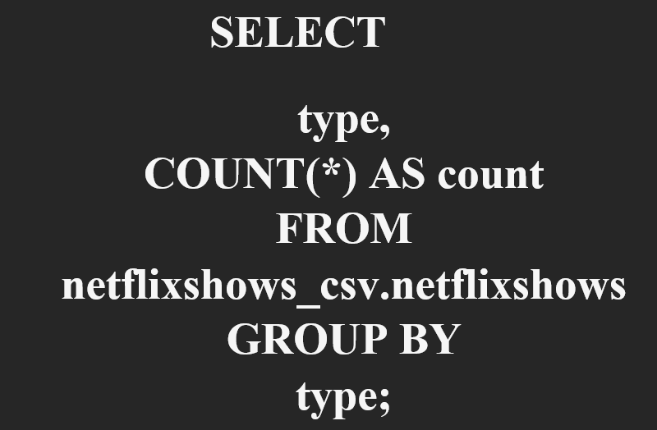
Netflix Insights: Content Ratings & Type Distribution
Counting Movies and TV Shows:
Another aspect I investigated was the breakdown of movies and TV shows in the dataset. By running a SQL query, I determined that there were a total of 100 shows in the dataset, which could be further categorized into 55 movies and 45 TV shows. This analysis helped in understanding the composition of content types within the Netflix catalog, showcasing the platform's diverse offerings across different formats.

Slide 8

Netflix Insights: Content Ratings & Type Distribution
Through these SQL queries and analyses, I gained valuable insights into the distribution of ratings among TV programs on Netflix and the composition of movies and TV shows in the dataset. These findings contributed to a deeper understanding of content trends and viewer preferences on the platform.

Slide 9
Visualizing Netflix Trends: Charts and Insights
Release Year Distribution
The chart shows the distribution of Netflix shows based on their release years. The data is grouped into four periods: 1970-1990, 1991-2000, 2001-2009, and 2010-2021.
From the chart, it is evident that there is a significant increase in the number of shows released from 2010 to 2021, with 80 shows in this period compared to just 4 from 1970-1990. This highlights Netflix's rapid growth and expansion in recent years, as well as its increasing investment in new content.

Slide 10
Visualizing Netflix Trends: Charts and Insights
Content Type Breakdown:
A pie chart illustrates the breakdown of content types, showing the proportion of movies versus TV shows.
The pie chart reveals a balanced mix of content, with 55 movies (55%) and 45 TV shows (45%). This balance demonstrates Netflix's strategy to provide a variety of content to cater to different viewer preferences.

Slide 11
Visualizing Netflix Trends: Charts and Insights
Ratings Distribution:
A bar chart can be used to display the number of TV programs under different ratings, such as TV-MA, TV-14, and TV-G.
This chart shows that TV-MA is the most common rating among Netflix shows, indicating a strong preference for mature content. In contrast, TV-G has the least representation, highlighting the platform's focus on more mature audiences.

Slide 12

Project Summary
I explored Netflix's extensive show catalog to uncover insights into viewer preferences and content trends. Using MySQL tools, I analyzed ratings distribution among TV programs, finding that TV-MA and TV-14 were popular ratings, while TV-G had limited representation. Additionally, I discovered a diverse range of genres, including notable surges in sci-fi fantasy and crime thrillers. The dataset included 100 shows, with a balanced mix of 55 movies and 45 TV shows. This project enhanced my skills in data analysis and SQL querying, providing valuable insights into key trends in the entertainment industry.

